Slide 1
Stock Trends Website

Slide 2
Abstract
This project is a website that displays stock price information for a specific company. Users can input the company's ticker symbol, and the website will display current stock prices as well as historical data. The website also includes charts and graphs to visually display the stock's performance over time. The website is user-friendly and easy to navigate, making it a convenient tool for investors and traders to stay up-to-date on their investments. Additionally, the website is responsive and can be accessed on any device. Overall, this project aims to provide a reliable and accessible source of stock market information for individual investors.

Slide 3
Introduction
This is a web development project which gives the stock price history of a company stock by its name .It helps the users better understand the company stock performance and make informed decisions while buying a stock.
This website also provide information regarding crypto currencies it also shows the user information regarding todays best performing stock

Slide 4
Overview
Stock market on an average provides 13%growth every year so it is important for every on to have basic knowledge about stock market Our website is user friendly any one can use it very easily.

Slide 5
System Requirements
This project is build using HTML ,CSS ,and Java Script. So it doesn’t need more then basic bowser like Chrome and a good enough internet connection.

Slide 6
Working
This website works by taking in the stock name of a stock from the user and then accessing the previous stock prices from Yahoo finance API and mapping them though Chart JS.

Slide 7
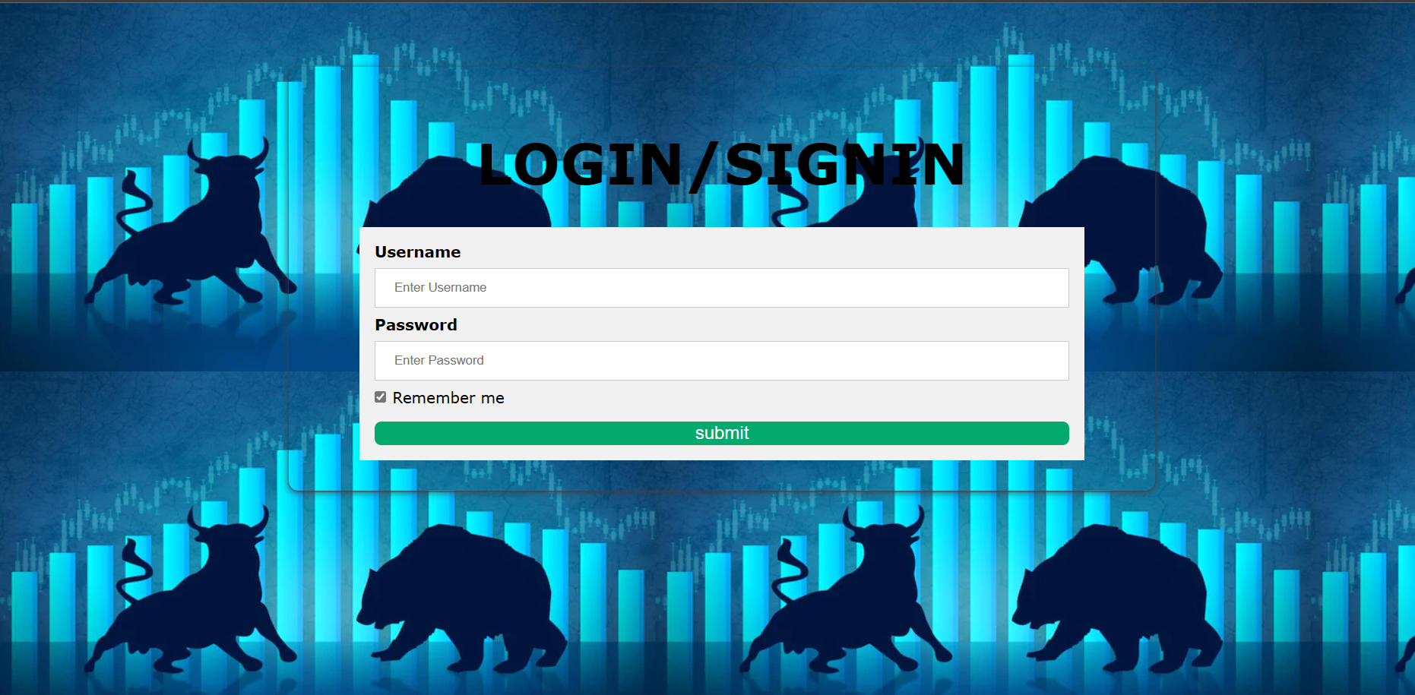
Initial login page
Asks the user for his userId and password

Slide 8
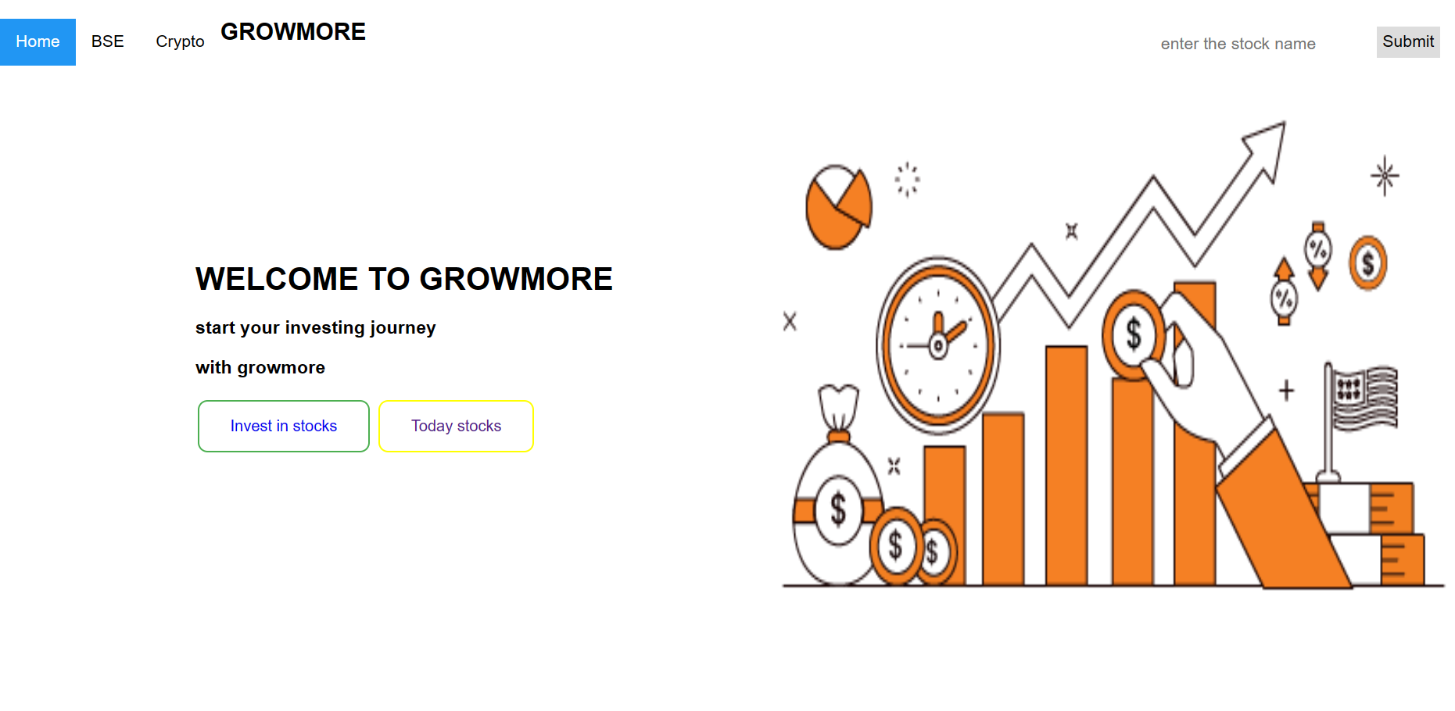
Search bar
Ask the user for the name of the stock to show the trends.

Slide 9
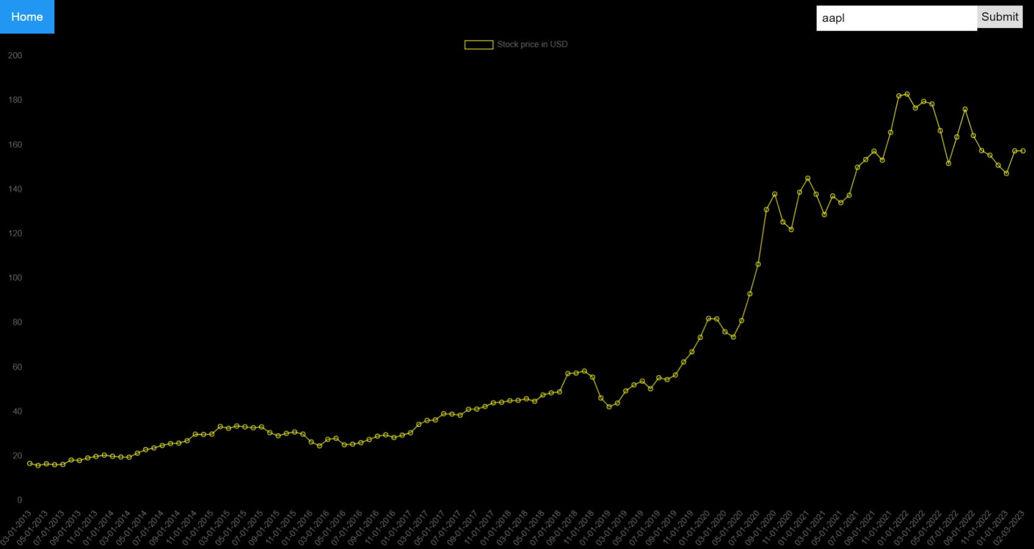
Stock trends graph
On entering the stork name and clicking submit an interactive stock graph is shown

Slide 10
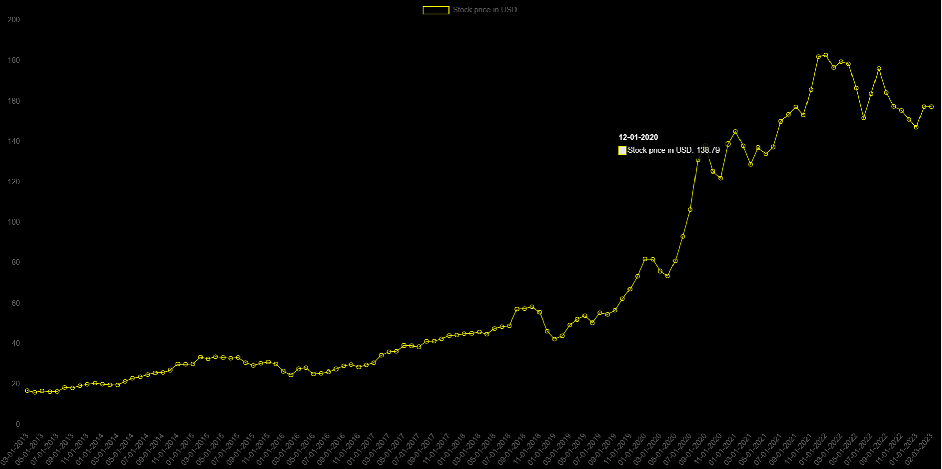
Interactive graph
User can know the price at a particular day by hovering the mouse on the graph

Slide 11
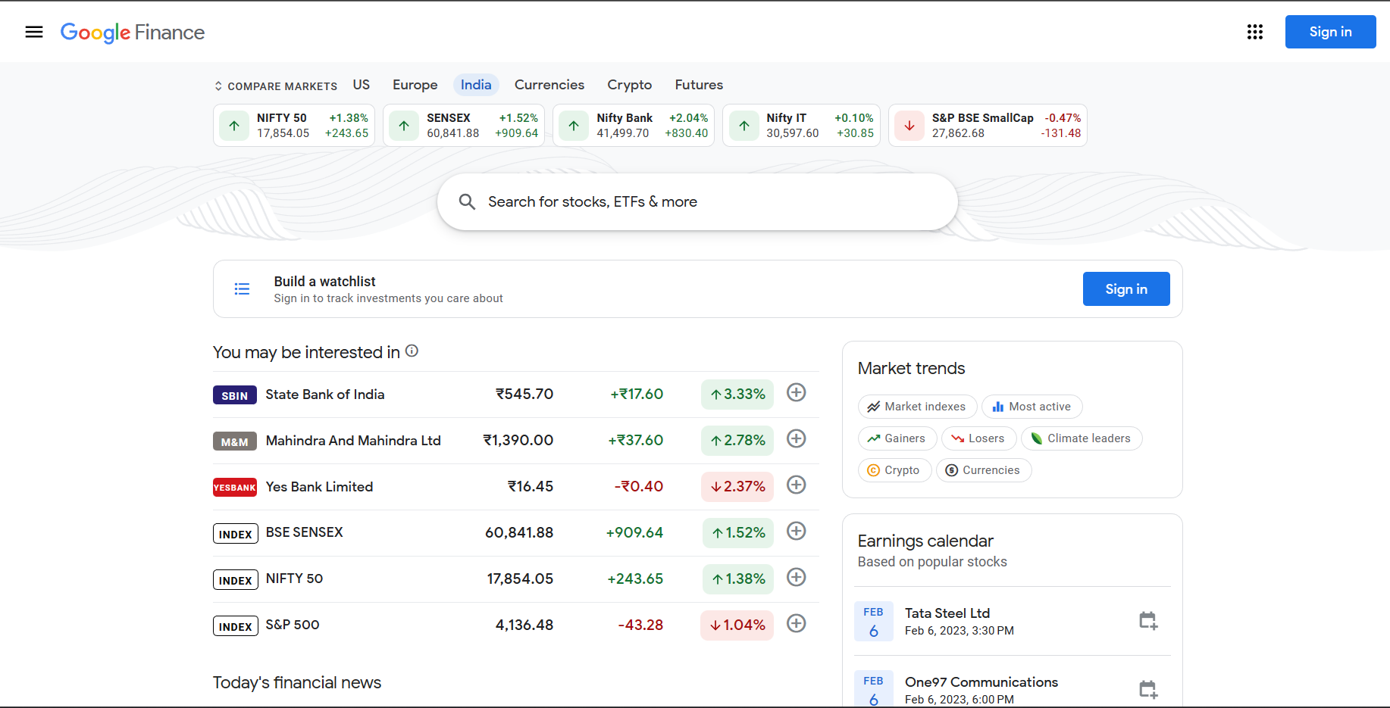
Trending stocks
User can also access trending stocks from google finance by clicking on today’s stocks button

Slide 12
Future work
Provision for trending stocks will be done in website instead of google finance.
User can see predictions of future stock trends through website.
User will also be suggested stocks based upon the risk he is willing to endure.
Crypto currency prices can also be accessed.

Slide 13
References
MDN web docs
Rapid API
Chart JS
W3Schools

Slide 14
THANK YOU!

